Slide 1
For the Strength of Youth Conferences

Slide 2


For the Strength of Youth Conferences
Notes:
For the Strength of Youth conferences are an anchor to the Children and Youth program. Young single adults play a massive role in these conferences.. [other introduction to the presentation as desired]

Slide 3
FSY Objective
Youth and young single adults that attend are strengthened in their testimonies of Jesus Christ, have an increase in their sense of belonging, and continue spiritual experiences they have had at FSY at home.
Notes:
The intent of this presentation is to help you understand the objective of FSY, which is that:
Youth and young single adults that attend are strengthened in their testimonies of Jesus Christ, have an increase in their sense of belonging, and can continue spiritual experiences they have had at FSY at home
[click]

Slide 4
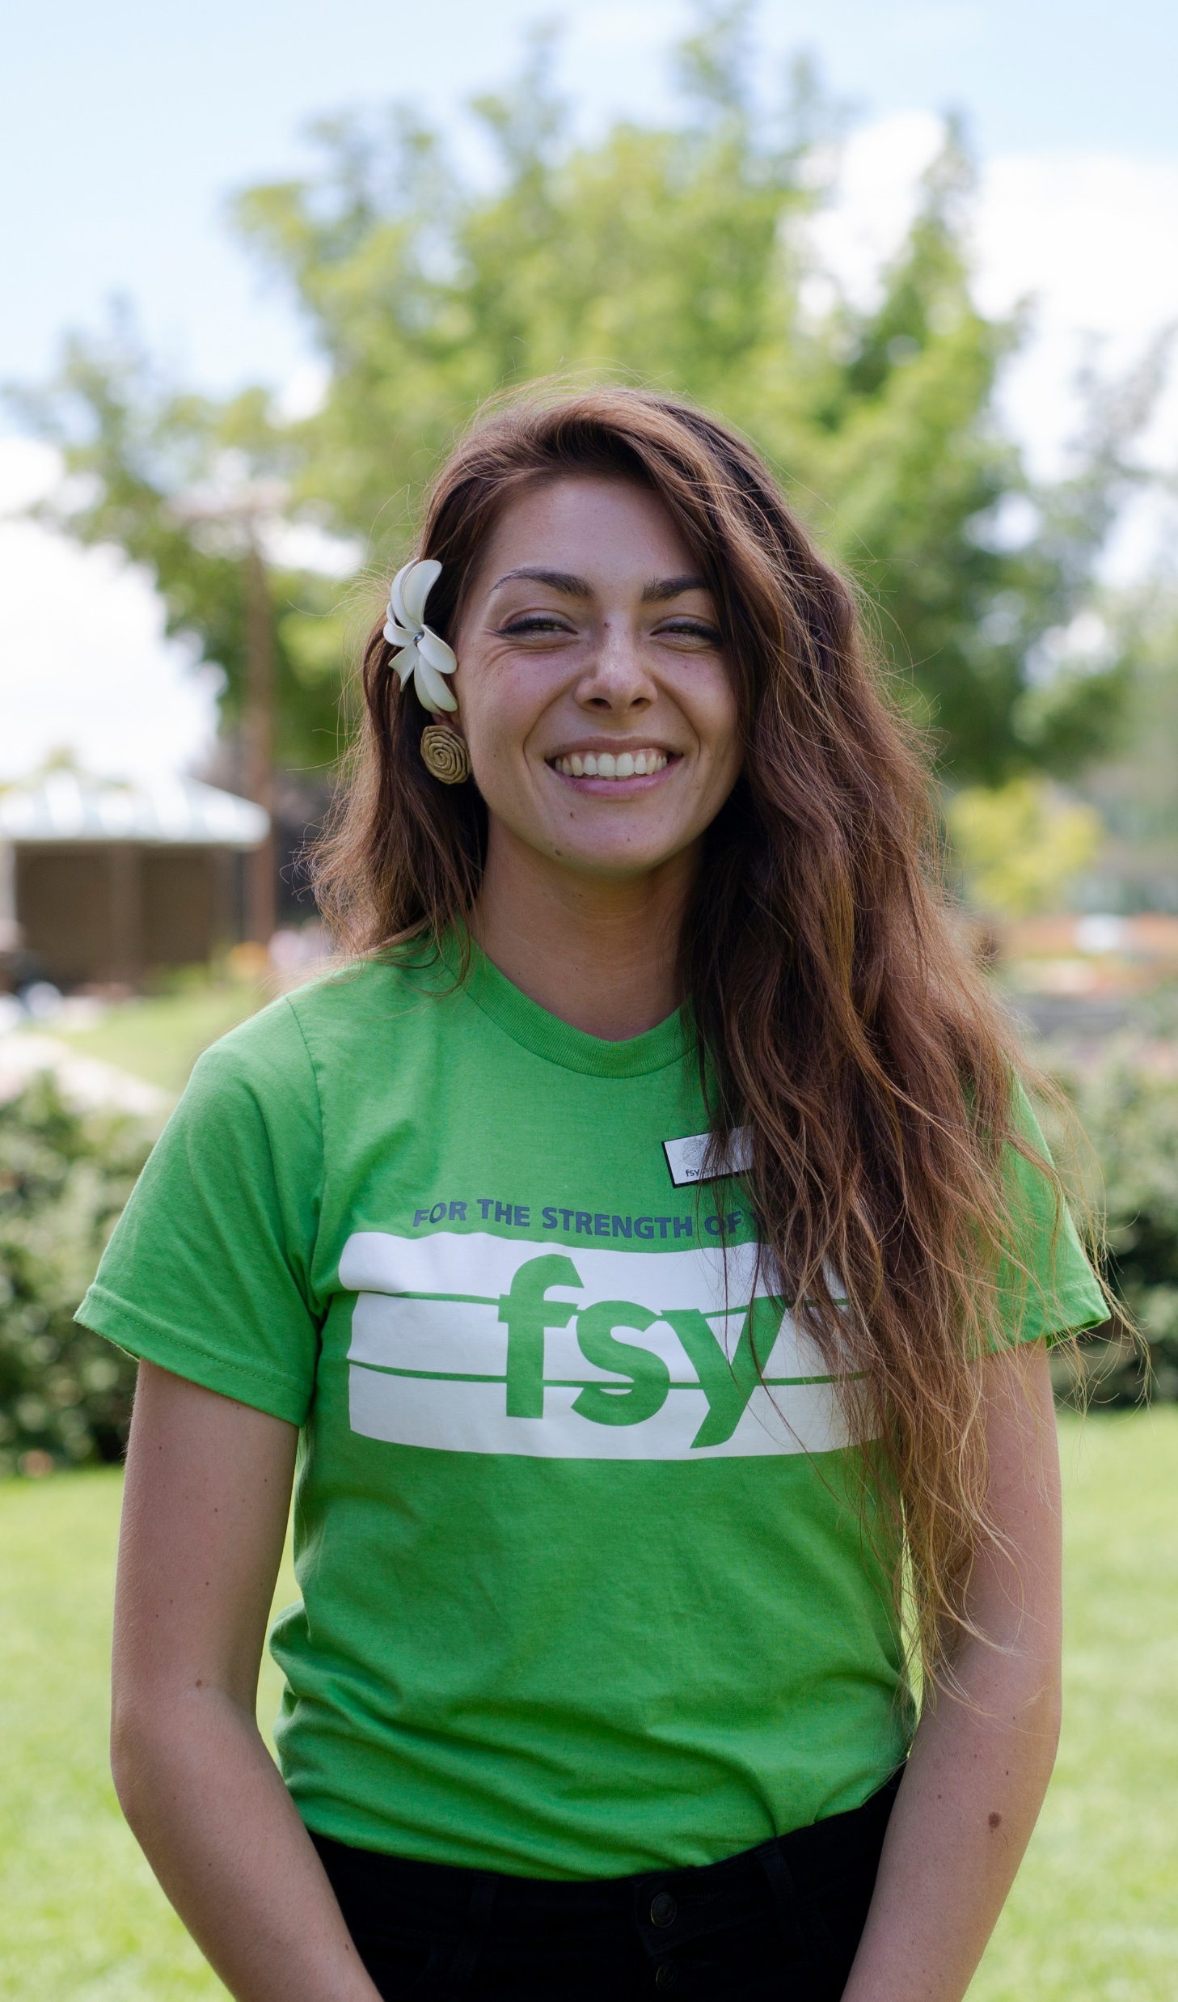
Goals
Increase the involvement and participation of youth and YSA in FSY
Facilitate calling those with FSY responsibilities at the stake and ward levels
Notes:
Two additional goals of this presentation are to help Areas understand that they are responsible to:
Increase the involvement and participation of youth and YSA in FSY and
Facilitate calling those with FSY responsibilities at the coordinating council, stake, and ward levels
[click]

Slide 5
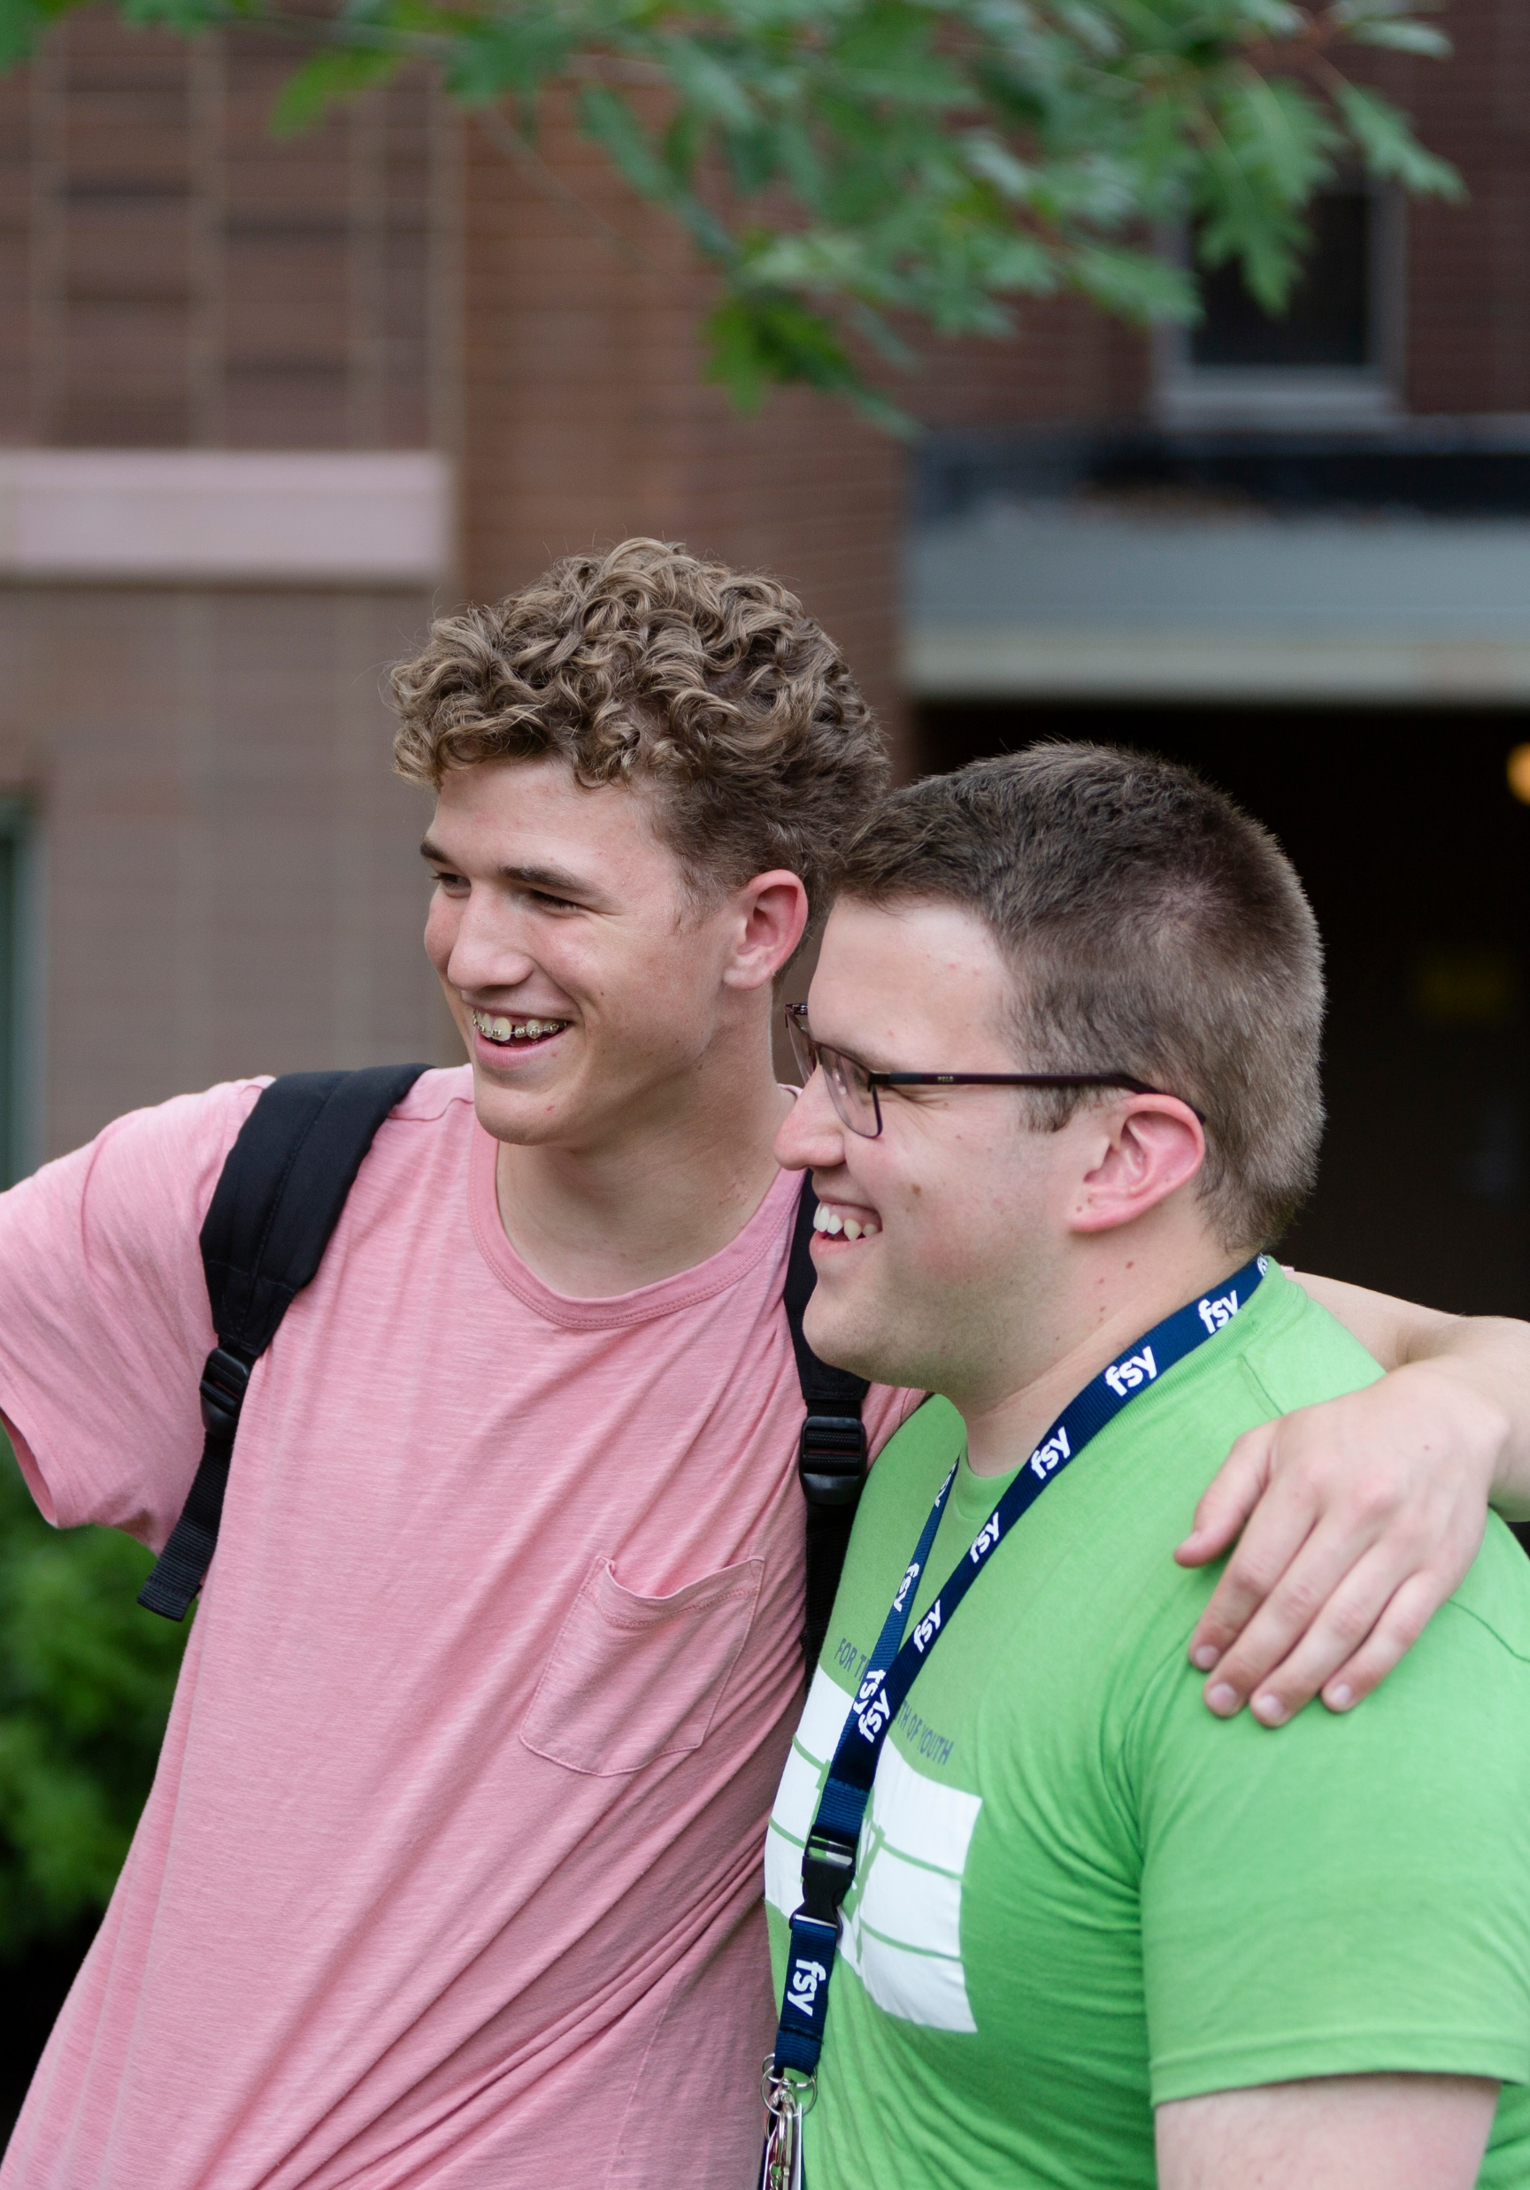
Area Centered, Headquarters Supported
Area Responsibility
Youth turning 14-18 in half of the stakes attend each year (150,000 youth)
Young single adults as counselors and assistant counselors
Notes:
To increase the success of FSY conferences, we have been given direction to move to an Area centered, headquarters supported model. In 2022, the following items will fall under Area responsibility:
Youth turning 14-18 years old in half of the stakes will attend each year (FSY has reserved beds for 150,000 youth across the US and Canada). Stakes are responsible for ensuring these youth are approved and registered.
As YSA stakes, your attention will be more on the young single adults who will serve as counselors and assistant counselors. Stakes are to encourage young single adults to apply. [see slide 22]
[click]

Slide 6
Area Centered, Headquarters Supported
FSY Office at Church Headquarters Responsibility
Stake schedule
Registration
Session logistics
Instructional materials
Securing college campuses
Assigning and training staff, including session directors and teachers
A large part of the funding
Notes:
The following items fall under the FSY office at headquarters.
Stake schedule
Registration
Session logistics
Instructional materials
Securing college campuses
Assigning and training staff, including session directors and teachers
And providing a large part of the funding
[click]

Slide 7
FSY Conference Staff
FSY Office at Headquarters
Counselors
(YSA)
Assistant Counselors (YSA)
Notes:
There are two primary roles in FSY outside of headquarters that we want to make you aware of.
[click]

Slide 8
FSY Conference Staff
FSY Office at Headquarters
Counselors
(YSA)
Assistant Counselors (YSA)
Notes:
First are the counselors. These are young single adults that are recruited by headquarters with support from the Area, stakes, and wards, which is a new calling we will discuss later in the presentation, and stake and ward leaders.

Slide 9
Counselor Information
Counselors teach and mentor 10 youth per week for an average of 7 weeks
Online applications for 2,200 FSY counselors are open
Headquarters recruits YSA with help from Area and local leaders in encouraging highly qualified YSA to apply
Headquarters selects counselors
Counselors receive training, food, housing, and a weekly allowance; enhance resume, internship, experience for future careers and family life
Notes:
Counselors will teach and mentor about 10 youth per week for an average of 7 weeks
Online applications for the 2,200 FSY counselor positions are open
Headquarters will recruit young single adults with significant help from Area and local leaders in encouraging highly qualified YSA to apply.
Then headquarters will select those who become FSY counselors. Not all applicants will be selected.
Counselors will receive training, food, housing, and a weekly allowance. This could also enhance the resumes of the YSAs who participate, potentially serve as an internship, and give them vital experience for future careers and family life.
Note that counselors in the United States have to get themselves to Provo at the beginning of the summer, which may mean that the majority of FSY’s counselors will come from Utah and surrounding states. Consequently, FSY needs significant help in the recruitment effort in Utah.
[click]

Slide 10
FSY Conference Staff
FSY Office at Headquarters
Counselors
(YSA)
Assistant Counselors (YSA)
Notes:
Second are the assistant counselors. These are young single adult volunteers that are recruited by the Area, stake, and ward leaders.

Slide 11
Assistant Counselor Information
For 2022, assistant counselor spots are limited (numbers needed will be shared prior to application opening); more opportunities in the future
YSA currently living in Utah, such as college students, may serve as assistant counselors outside of Utah
Assistant counselors serve alongside counselors to support 10 youth and will serve locally for 1 week
Local leaders recruit outstanding YSA to apply with help from headquarters
Selection is made by headquarters based on need and bishopric recommendation level
Must be recommended by bishoprics in late January 2022, prior to application
Assistant counselors receive only training, food, and housing
Notes:
For 2022, assistant counselor spots are limited. In Utah, all beds need to be used for youth and minimum staffing needs. This means no assistant counselor spots at this time will be available in the Utah Area. More opportunities for assistant counselors will be available in the future.
It should be noted that YSA currently living in Utah, such as college students who might return home for the summer, may serve as assistant counselors outside of Utah. The number of assistant counselor spots for each campus will be shared with Areas prior to the applications opening.
Assistant counselors will serve alongside counselors to support about 10 youth and will serve locally for 1 week.
Area and local leaders will recruit applicants with help from headquarters.
After the YSA apply, they will be selected based on need and bishopric recommendation level.
YSA must be recommended by bishoprics when the tool is available in late January 2022, prior to application.
And assistant counselor will receive only training, food, and housing. This could do the same as the counselor position in enhancing the resumes of the YSAs who participate, potentially serving as an internship, and giving them vital experience for future careers and family life.
[click]

Slide 12
Communication Flow
FSY Office at Church Headquarters
Area Presidency
Coordinating Council (Area Seventy, FSY representatives)
Stake (presidency, YSA RS presidents)
Ward (bishopric, FSY representative)
Notes:
Communication about FSY will follow the regular flow from
The FSY office at Church headquarters down to
The ward level

Slide 13
Communication Flow
FSY Office at Church Headquarters
Area Presidency
Coordinating Council (Area Seventy, FSY representatives)
Stake (presidency, YSA RS presidents)
Ward (bishopric, FSY representative)
Notes:
First, we’ll discuss the role of the new calling of coordinating council FSY representative

Slide 14
Coordinating Council FSY Representatives
Instruct YSA stake Relief Society presidents in responsibilities
Review assistant counselor reports on FSY website and follow up, as needed
Be very familiar with FSY.ChurchofJesusChrist.org
Notes:
Coordinating council FSY representatives should work together to:
Instruct YSA stake Relief Society presidents in their FSY related responsibilities
Frequently review assistant counselor reports on the FSY website and follow up with stake leaders, as needed
And be very familiar with FSY.ChurchofJesusChrist.org
[click]

Slide 15
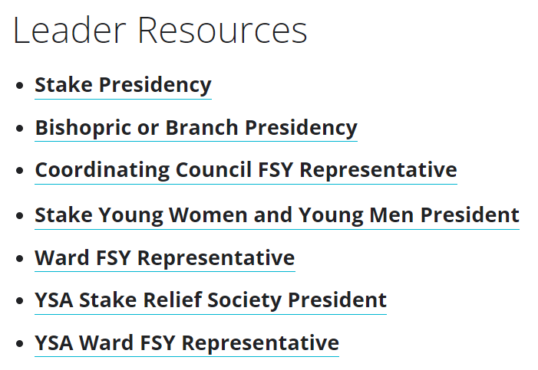

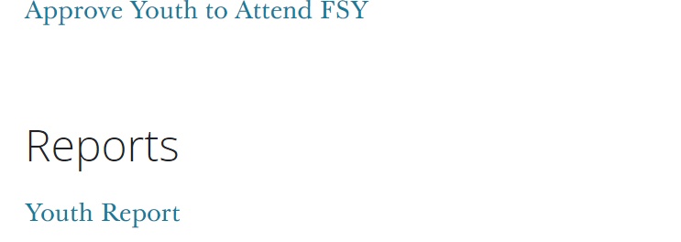
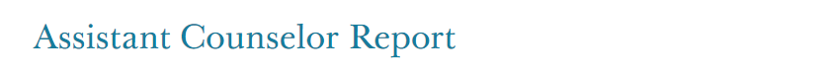
FSYLeader.ChurchofJesusChrist.org
Notes:
These are screen captures from the FSYLeader.ChurchofJesusChrist.org website. As shown, the coordinating council FSY representatives, and all callings shown in the list on the left, have access to the assistant counselor reports, as shown on the right. Note that only bishopric members will have access to the approval tool, which we will discuss later.
[click]

Slide 16
Communication Flow
FSY Office at Church Headquarters
Area Presidency
Coordinating Council (Area Seventy, FSY representative)
Stake (presidency, YSA RS presidents)
Ward (bishopric, FSY representative)
Notes:
Next, we’ll discuss the role of the stake presidency

Slide 17
Stake Presidency
Personally invite YSA to apply to serve with FSY and encourage bishoprics to do the same
If desired, use assistant counselor reports on FSY website for planning and follow up, as needed
Notes:
Stake presidency members should:
Personally invite YSA to apply to serve with FSY and encourage bishoprics to do the same
And, if desired, stake presidency members may use the assistant reports on the FSY website for planning and follow-up, as needed
[click]

Slide 18
Communication Flow
FSY Office at Church Headquarters
Area Presidency
Coordinating Council (Area Seventy, FSY representative)
Stake (presidency, YSA RS presidents)
Ward (bishopric, FSY representative)
Notes:
Next, we’ll discuss the role of the stake YSA relief society presidents

Slide 19
Relief Society President in YSA Stake
Instruct ward FSY representatives in their responsibility to encourage highly qualified YSA to apply to serve with FSY
Review assistant counselor reports on FSY website and follow up, as needed
Personally invite YSA to serve with FSY
Be very familiar with FSY.ChurchofJesusChrist.org
Notes:
Relief Society presidents in YSA stakes should:
Instruct ward FSY representatives in their responsibility to encourage highly qualified young single adults to apply to serve with FSY
Frequently review assistant counselor reports on the FSY website and follow up, as needed
Personally invite YSA to serve with FSY
Be very familiar with FSY.ChurchofJesusChrist.org
[click]

Slide 20
Communication Flow
FSY Office at Church Headquarters
Area Presidency
Coordinating Council (Area Seventy, FSY representative)
Stake (presidency, YSA RS presidents)
Ward (bishopric, FSY representative)
Notes:
Next, we’ll discuss the role of the bishopric

Slide 21
Bishopric
Encourage highly qualified YSA to apply to be counselors
Recommend highly qualified YSA to apply to be assistant counselors on tool in LCR beginning late January 2022
If desired, review assistant counselor reports on FSY website and follow up, as needed
Notes:
Bishoprics should:
Encourage highly qualified YSA to apply to be counselors
Recommend highly qualified YSA to apply to be assistant counselors on the tool in LCR beginning late January 2022 [see slide 22]
If desired, bishopric members may review assistant counselor reports on the FSY website and follow up, as needed
[click]

Slide 22
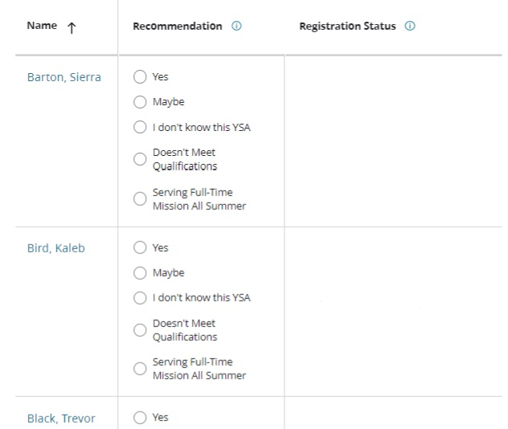
Assistant Counselor Recommendation Tool
Notes:
Instructions for completing assistant counselor recommendations are included on the individual tool which will be available late January. This slide shows a screen capture of the assistant counselor recommendation tool. All YSA in a ward who fit in the appropriate age range will be displayed and bishoprics will need to mark their recommendation level. Once a YSA applies, the session(s) they applied for will be listed on the right.
[click]

Slide 23
Communication Flow
FSY Office at Church Headquarters
Area Presidency
Coordinating Council (Area Seventy, FSY representative)
Stake (presidency, YSA RS presidents)
Ward (bishopric, FSY representative)
Notes:
Next, we’ll discuss the role of the ward FSY representative

Slide 24
Ward FSY Representative
Support bishopric in recommending highly qualified YSA to be assistant counselors
Encourage highly qualified YSA to apply to be counselors
Review assistant counselor reports on FSY website and follow up, as needed
Be very familiar with FSY.ChurchofJesusChrist.org
Notes:
Ward FSY representatives should:
Support bishopric members in recommending highly qualified young single adults to be assistant counselors
Encourage highly qualified young single adults to apply to be counselors
Frequently review assistant counselor reports on the FSY website and follow up, as needed
And be very familiar with FSY.ChurchofJesusChrist.org
[click]

Slide 25
Timeline
October 14 – YSA begin applying for the counselor position
November 4 – Bishopric call and set apart ward FSY representative
Late January – Bishoprics recommend YSA as assistant counselors
Late January – YSA begin applying for the assistant counselor position
Early November – Headquarters provide training documents to FSY representatives and YSA stake RS presidents
4 weeks prior to sessions – Assistant counselor applications close
Notes:
This slide and the next are a timeline of the upcoming items for the 2022 FSY cycle as it applies to YSA stakes.

Slide 26
Summary
Increase the involvement and participation of YSA in FSY
Facilitate calling those with FSY responsibilities at the coordinating council, stake, and ward levels
Help youth and YSA strengthen their testimonies of Jesus Christ, increase their sense of belonging, and continue spiritual experiences at home
FSYLeader.ChurchofJesusChrist.org
Notes:
The three main goals for YSA stake and ward leaders should be to:
Increase the involvement and participation of YSA in FSY
Facilitate calling those with FSY responsibilities at the stake and ward levels and
Help YSA strengthen their testimonies of Jesus Christ, increase their sense of belonging, and continue spiritual experiences at home

